Slide 1

Automated Electronic Toll System Using LPR
Department of Electronics and Telecommunications
Group Members:
Aruna Shaju K 29
Yash Marathe 36
Nikhil Patil 46
Riya Thomas 67
Guide: Dr. Nadir Charniya
Professor, Electronics and Telecommunication Department

Slide 2
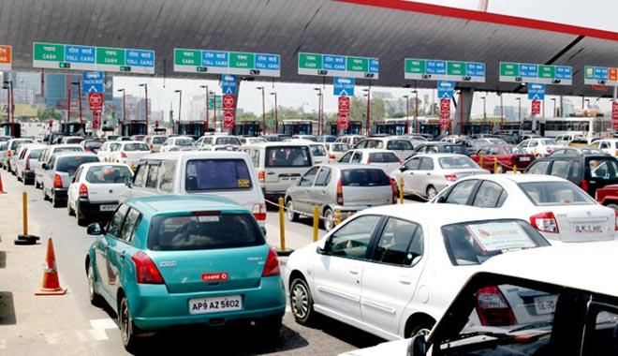
Current Situation at the Toll Centers

Slide 3
Problem Statement
Manual collection of toll
Traffic and unnecessary delay at tolls
Improper traffic handling and money exchanges.
The digitizing of wallets will lead to people carrying less cash and in turn less traffic mismanagement.
Thus a fully automated e-toll system is proposed.

Slide 4
Current E-Toll System
The current E-toll system is implemented using RFID tags( FastTag Cards).
The RFID Tags can we charged through E-wallets or online banking options.
There has been major drawbacks due to tags not getting detected and non-Tag commuters entering the lane reserved for the latter.

Slide 5
Current E-Toll System
This has led to increased traffic in some cases.
Thus, instead of introducing a new system altogether, using the current license plate database is proposed.

Slide 6
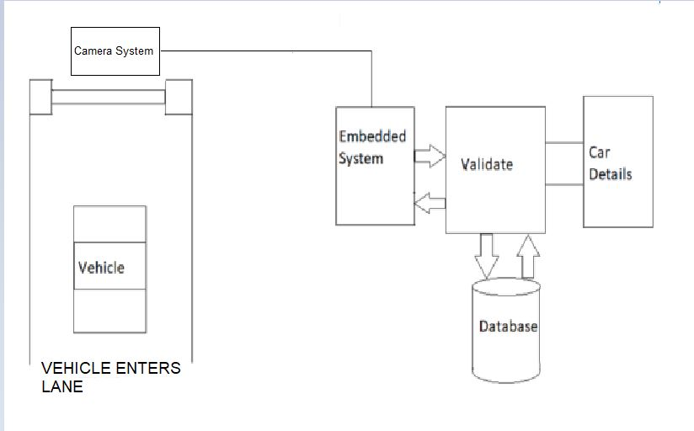
Proposed Implementation

Slide 7
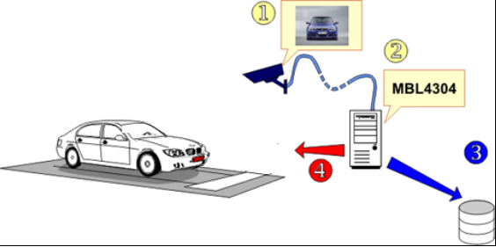

Slide 8
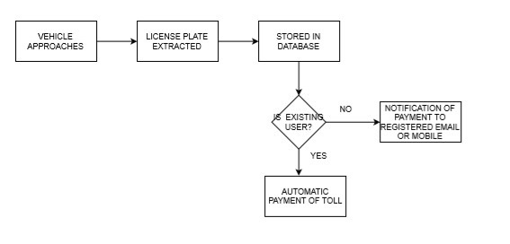

Slide 9
Capturing of License Plate
The camera is installed after the speed breaker system.
On the vehicle coming within a distance of the camera, the camera records a video of the vehicle.
Obstruction sensors, Piezoelectric sensors or White Line method are proposed to signal camera of the threshold distance.
The recorded video shall be sent to license plate recognition system.

Slide 10
License Plate Detection and Extraction
Plate detection:
Pre-processing - involving blurring, gray scaling, edge detection, thresholding
Contour detection
Analysing contours to detect license plate.
Cropping the detected license plate area.

Slide 11
Character Recognition
Segmentation of license plate characters.
Using Tesseract.
Detecting correct license no. from data.

Slide 12
SEM 7 Implemented Work - License Plate Detection And Extraction (Image Processing)

Slide 13
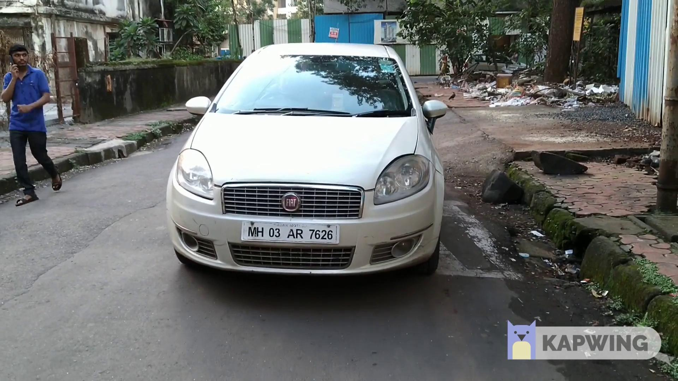

Slide 14
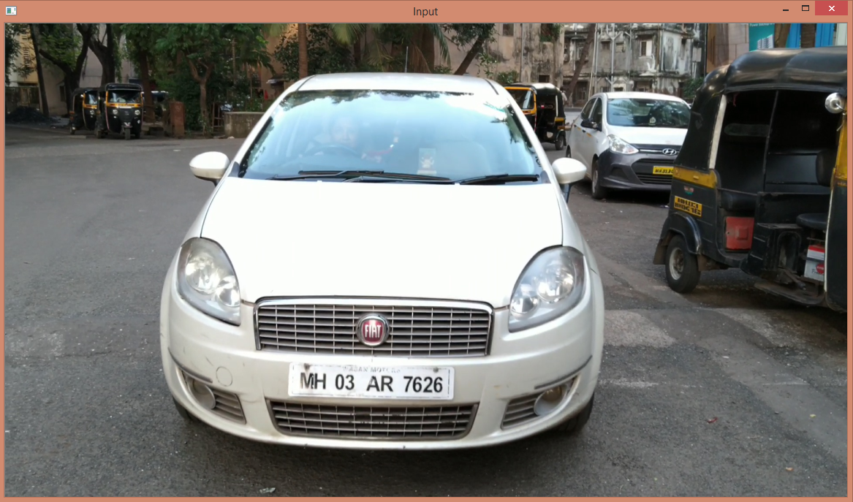
FRAME EXTRACTED

Slide 15
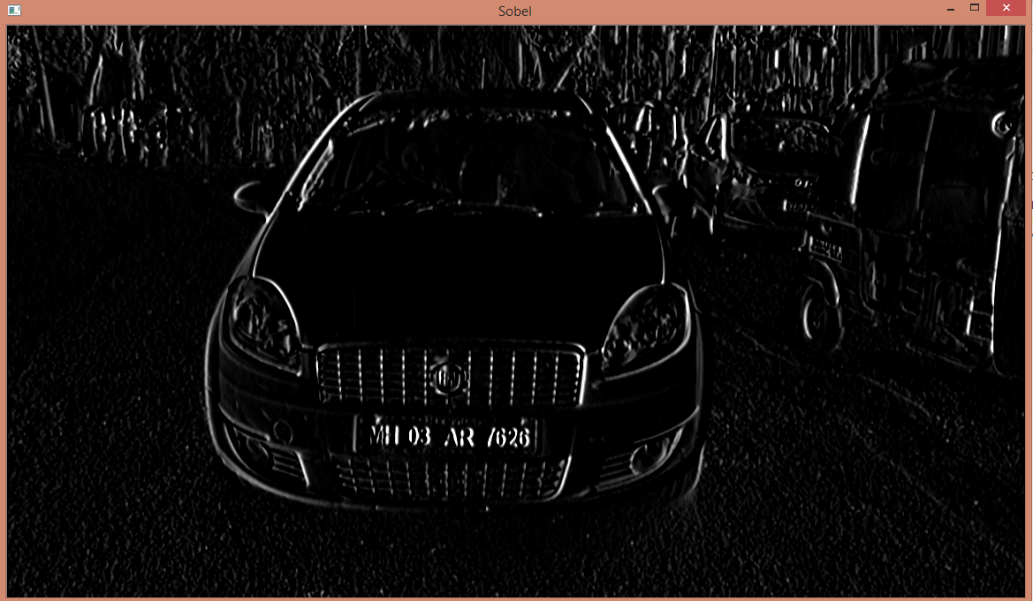
EDGE DETECTION

Slide 16
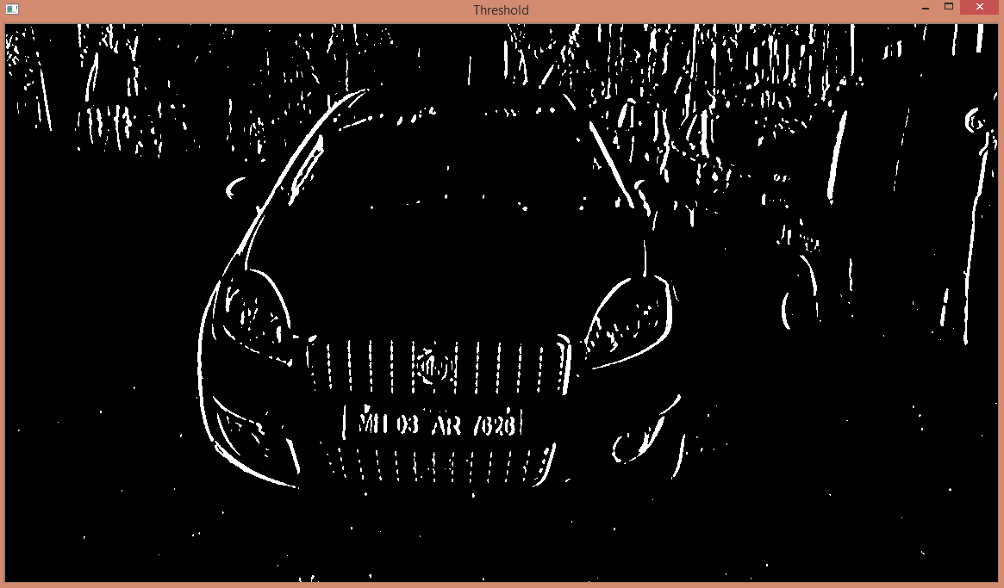
IMAGE THRESHOLDED

Slide 17
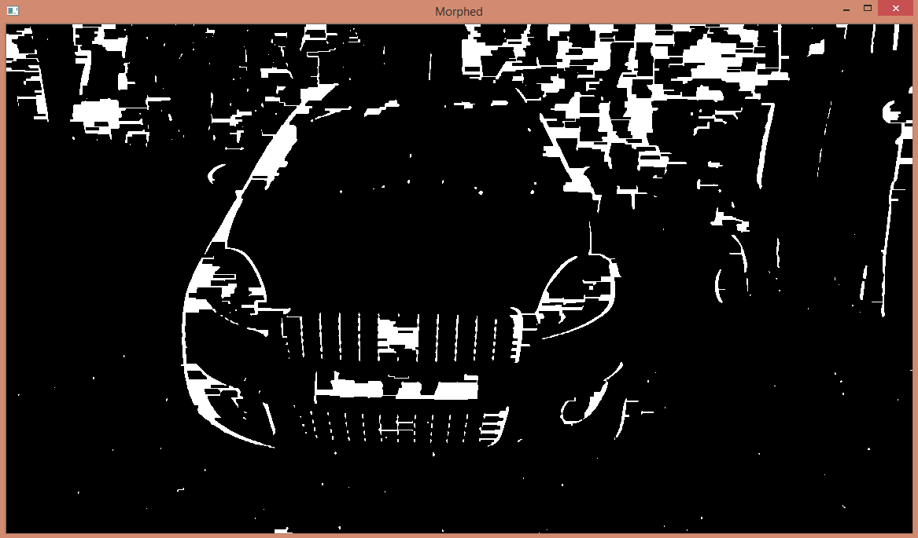
MORPHOLOGY - DILATION

Slide 18
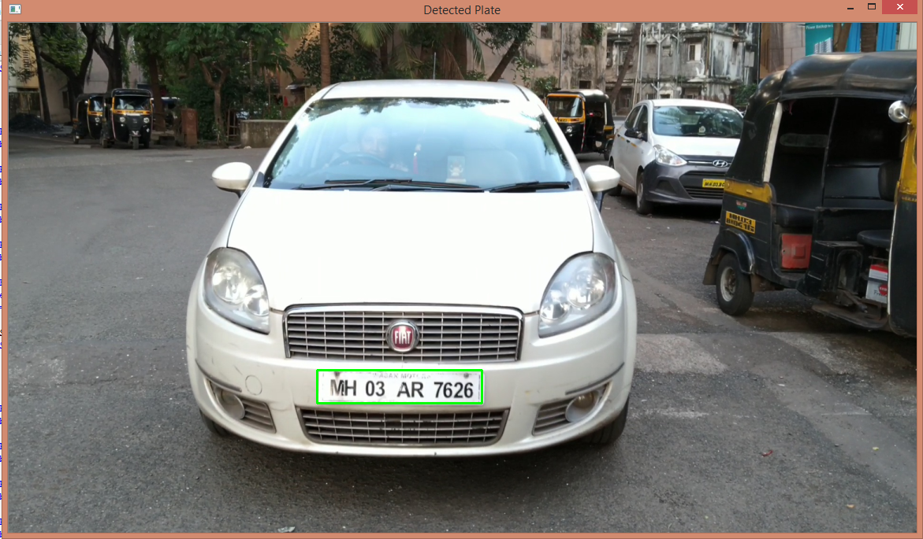
DETECTED BOUNDARY

Slide 19

CLEANED LICENSE PLATE

Slide 20
Required Camera Specifications
Sample video fps = 60
Sample video speed = 10km/hr = 2.77m/sec
Drag obtained per frame = 4.62cm
Required camera frame rate at 120km/hr = 720
Required camera frame rate at 40km/hr = 240 with speed breaker

Slide 21
SEM 8 Implemented Work - Integration of Digital Wallet and Database(Application Development)

Slide 22
E-wallet Implementation
Design an android app which the users will use to register their information and verify their number plates
Connected to the same firebase cloud database in which we are storing the characters retrieved.

Slide 23
We can integrate the app with Paytm or Paypal sdks as e-wallets to pay the amount.
As the vehicle is detected by the camera, it will get updated in the database and will be notified to the user via the app.

Slide 24
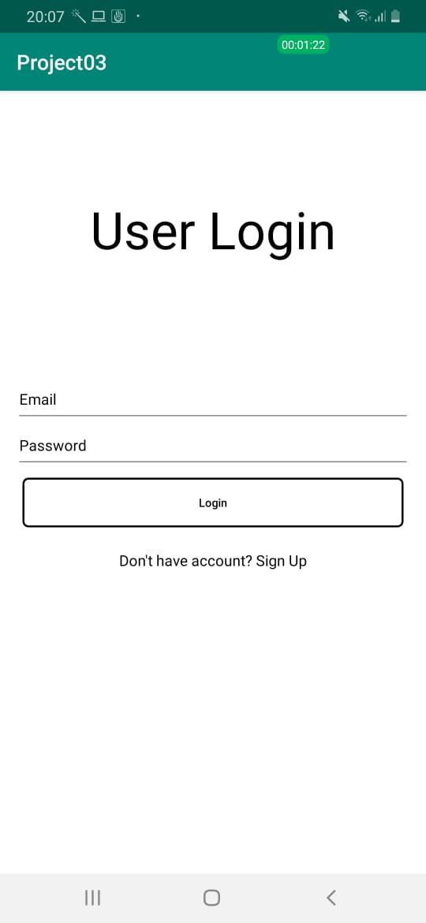
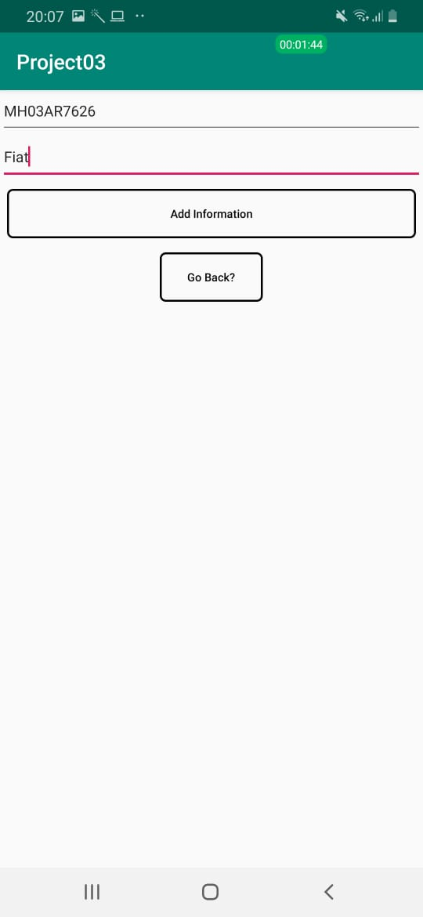

Slide 25
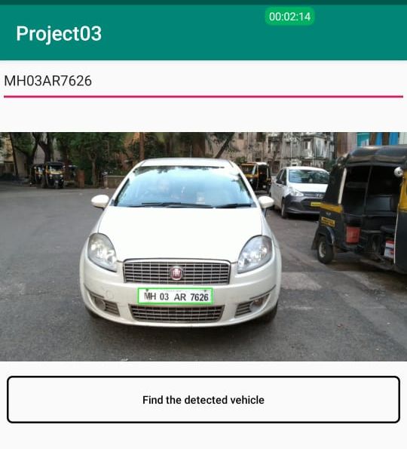

Slide 26
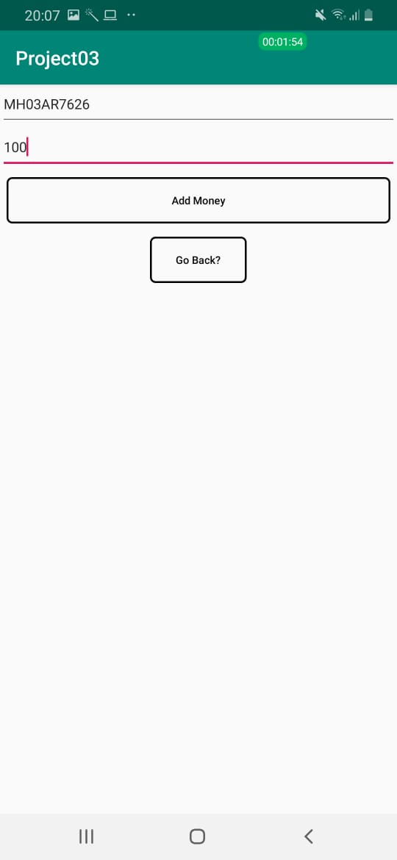


Slide 27
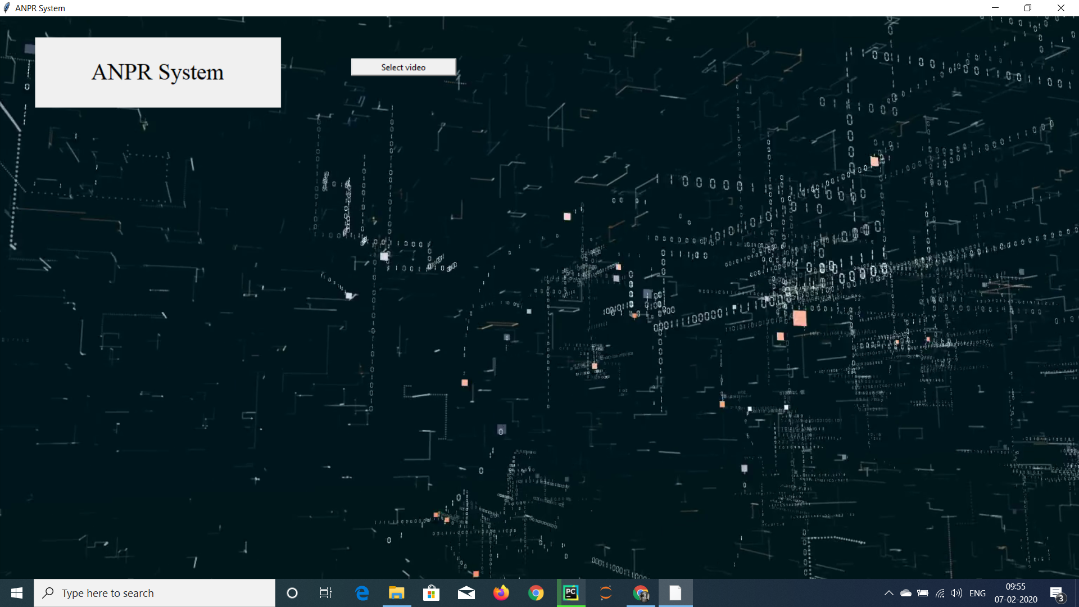

Slide 28
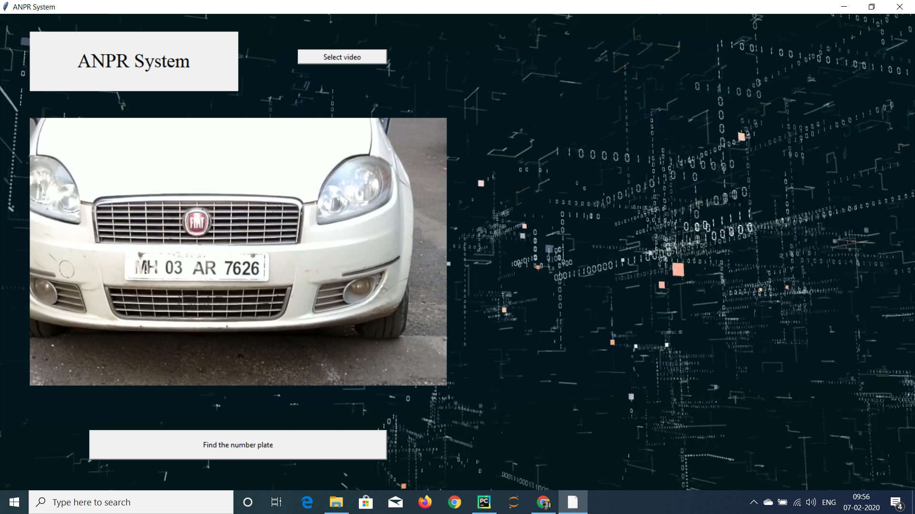

Slide 29
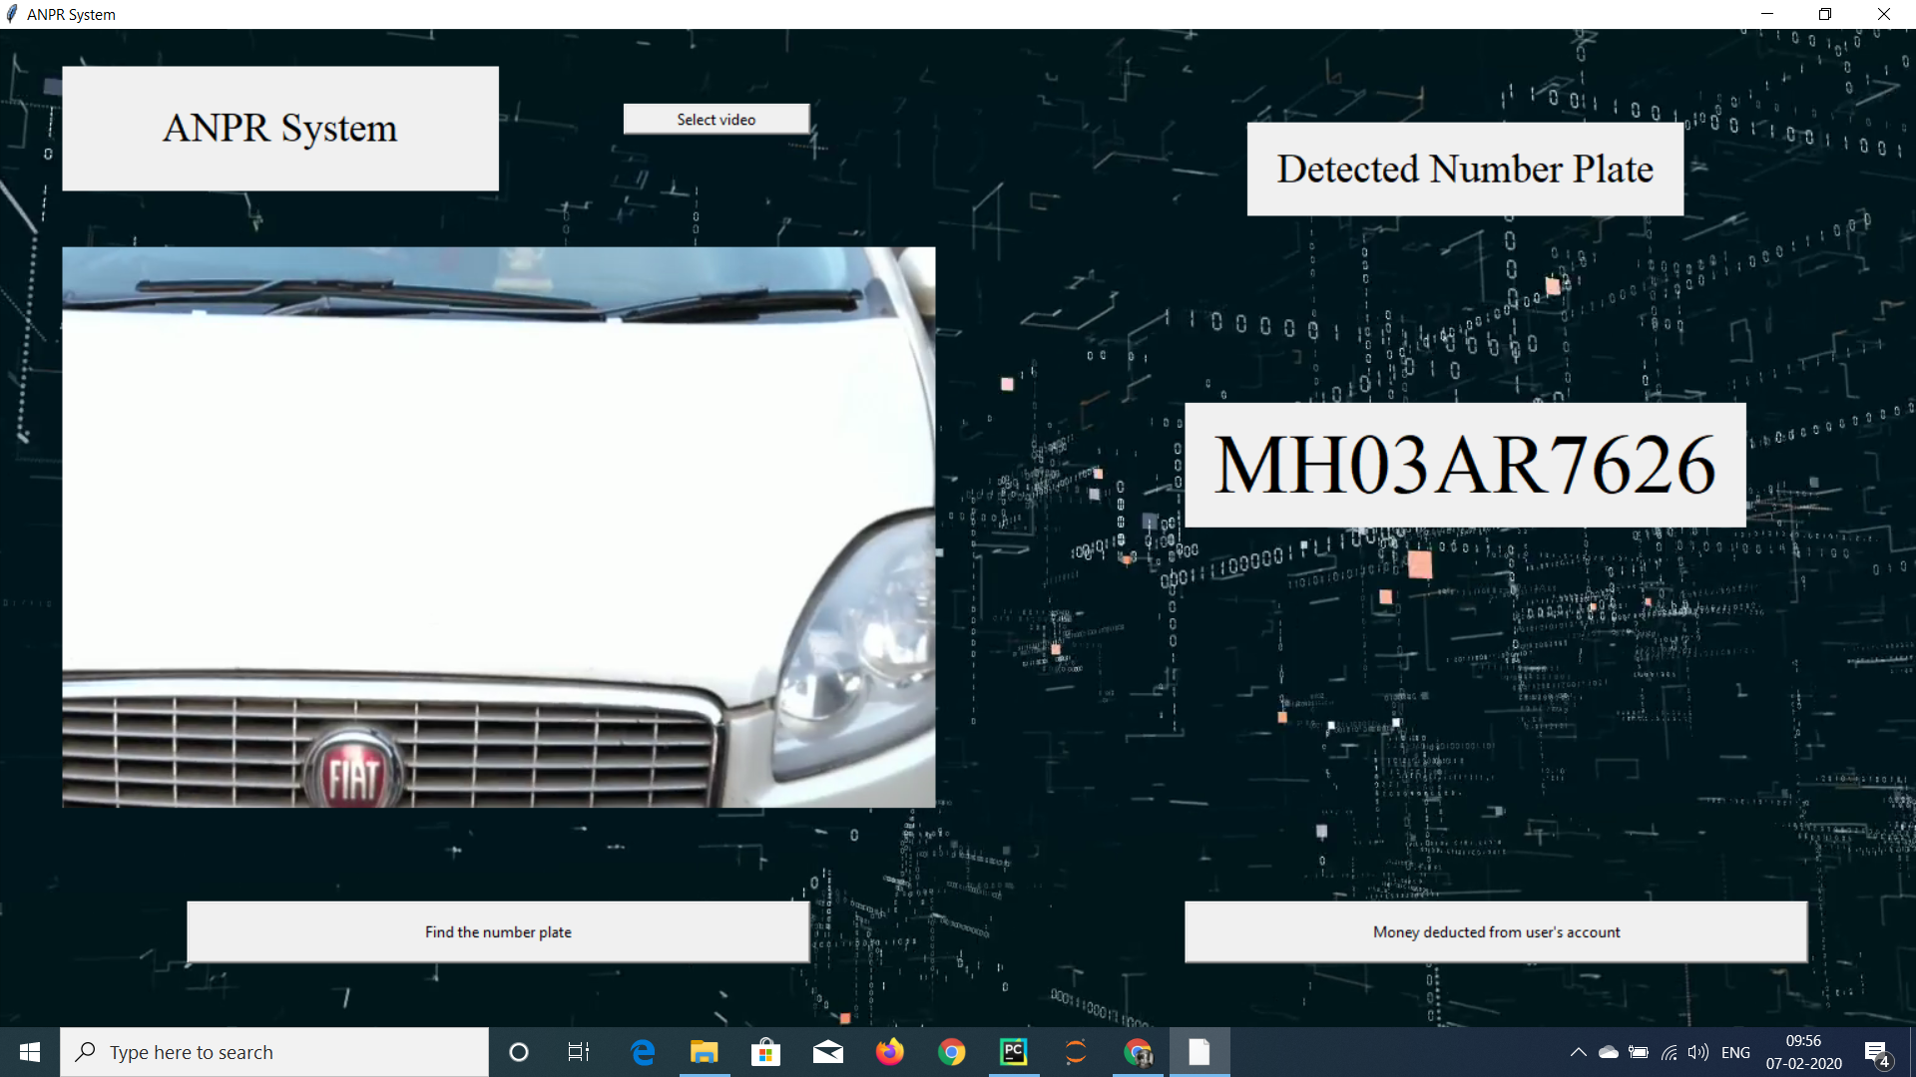

Slide 30
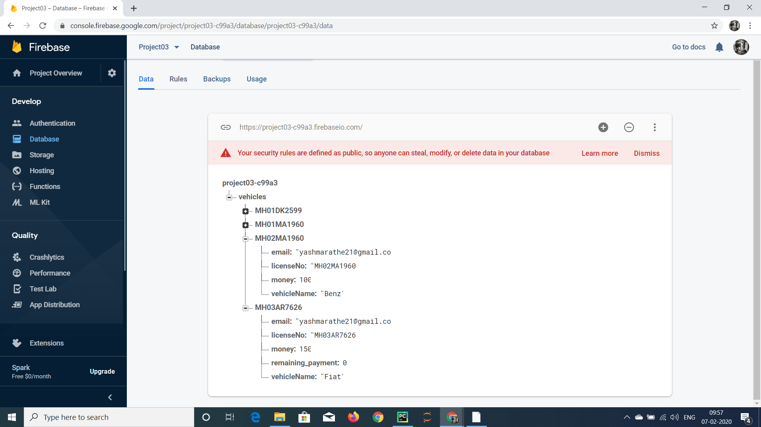

Slide 31
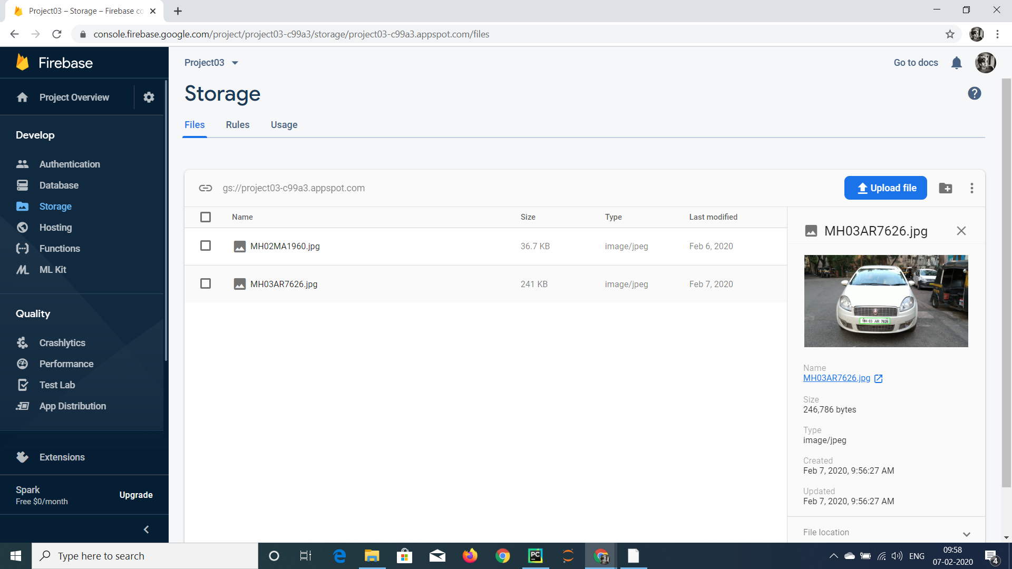

Slide 32
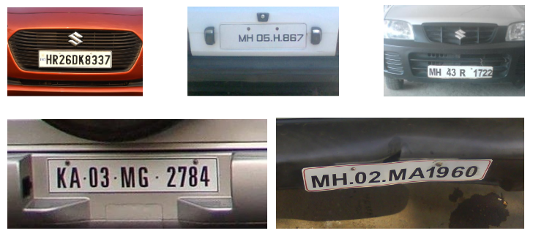
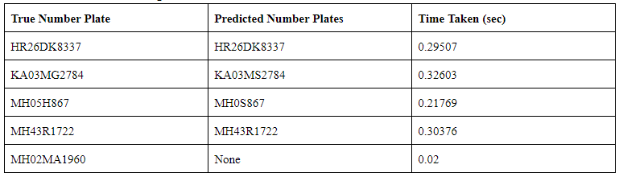
Results

Slide 33
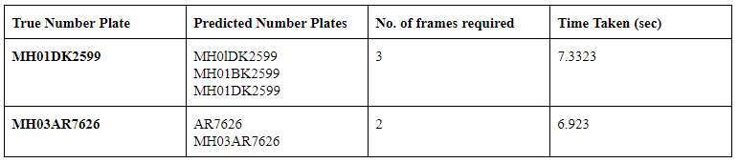

Slide 34
FEATURES OF SYSTEM
Existing feature of vehicle (License Plate and No sensor required on vehicle) used
Less labour required
Detection of Blacklisted Vehicles
Less Crowding, Faster Toll
Cashless Payment
Real Time Verification of License Plate

Slide 35
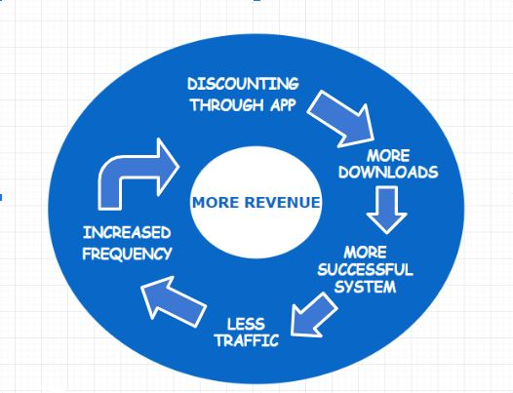

Slide 36
References
R Palekar, S Parab and D Parikh, (2017) “Real Time License Plate Detection using OpenCV and Tesseract”, International Conference on Communication and Signal Processing, India.
A K Singh and S Roy, (2015) “Automatic Number Plate Recognition Indian System using Surveillance Cameras”, New Delhi, India
M Olsen, J Hedman and Ravi Vatrapu, (2012) “Designing Digital Payment Artefacts”, International Conference on Electronic Commerce, Singapore.
Swati Sagar, (2016) “Vehicle Counting and Automated Toll Collection System using Image Processing” IJCSN International Journal of Computer Science and Network, Volume 5, Issue 2
M.A. Massoud, (2013) "Automated new license plate recognition in Egypt", Alexandria Engineering Journal 52, 319-326
Etqad Khan, Dipesh Garg, Rajeev Tiwari and Shuchi Upadhyay, (2018) “Automated Toll Tax Collection System using Cloud Database”, 3rd International Conference On Internet of Things: Smart Innovation and Usages (IoT-SIU), Bhimtal, India
https://cvisiondemy.com/license-plate-detection-with-opencv-and-python/

